Slide 1
Overview
take a glance at Lex!
CD LAB

Slide 2
Practical Exercise
1) Study of LEX Specifications, built in functions and variables.
CD LAB

Slide 3
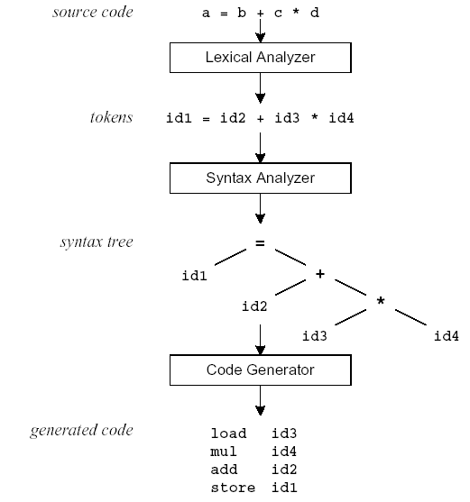
Compilation Sequence
CD LAB

Slide 4
What is Lex?
The main job of a lexical analyzer (scanner) is to break up an input stream into more usable elements (tokens)
  a = b + c * d;
  ID ASSIGN ID PLUS ID MULT ID SEMI
Lex is an utility to help you rapidly generate your scanners
CD LAB

Slide 5
Lex – Lexical Analyzer
Lexical analyzers tokenize input streams
Tokens are the terminals of a language
  English
    words, punctuation marks, …
  Programming language
    Identifiers, operators, keywords, …
Regular expressions define terminals/tokens
CD LAB

Slide 6
Lex Source Program
Lex source is a table of
  regular expressions and
  corresponding program fragments
digit [0-9]
letter [a-zA-Z]
%%
{letter}({letter}|{digit})* printf(“id: %s\n”, yytext);
\n printf(“new line\n”);
%%
main() {
yylex();
}
CD LAB

Slide 7
Lex Source to C Program
The table is translated to a C program (lex.yy.c) which
  reads an input stream
  partitioning the input into strings which match the given expressions and
  copying it to an output stream if necessary
CD LAB

Slide 8
An Overview of Lex
Lex source program
Lex
lex.yy.c
lex.yy.c
C compiler
a.out
input
a.out
tokens
CD LAB

Slide 9
Lex Source
Lex source is separated into three sections by %% delimiters
The general format of Lex source is
The absolute minimum Lex program is thus
{definitions}
%%
{transition rules}
%%
{user subroutines}
(required)
(optional)
%%
CD LAB

Slide 10
Lex v.s. Yacc
Lex
  Lex generates C code for a lexical analyzer, or scanner
  Lex uses patterns that match strings in the input and converts the strings to tokens
Yacc
  Yacc generates C code for syntax analyzer, or parser.
  Yacc uses grammar rules that allow it to analyze tokens from Lex and create a syntax tree.
CD LAB

Slide 11
Lex with Yacc
Lex source
(Lexical Rules)
Yacc source
(Grammar Rules)
Lex
Yacc
lex.yy.c
y.tab.c
call
yylex()
yyparse()
Parsed
Input
Input
return token
CD LAB

Slide 12
Regular Expressions
CD LAB

Slide 13
Operators
“ \ [ ] ^ - ? . * + | ( ) $ / { } % < >
If they are to be used as text characters, an escape should be used
\$ = “$”
\\ = “\”
Every character but blank, tab (\t), newline (\n) and the list above is always a text character
CD LAB

Slide 14
Character Classes []
[abc] matches a single character, which may be a, b, or c
Every operator meaning is ignored except \ - and ^
e.g.
[ab] => a or b
[a-z] => a or b or c or … or z
[^a-zA-Z] => any character which is not a
letter
CD LAB

Slide 15
Arbitrary Character .
To match almost character, the operator character . is the class of all characters except newline
CD LAB

Slide 16
Optional & Repeated Expressions
a? => zero or one instance of a
a* => zero or more instances of a
a+ => one or more instances of a
E.g.
ab?c => ac or abc
[a-z]+ => all strings of lower case letters
[a-zA-Z][a-zA-Z0-9]* => all alphanumeric strings with a leading alphabetic character
CD LAB

Slide 17
Precedence of Operators
Level of precedence
  Kleene closure (*), ?, +
  concatenation
  alternation (|)
All operators are left associative.
Ex: a*b|cd* = ((a*)b)|(c(d*))
CD LAB

Slide 18
Pattern Matching Primitives
Metacharacter | Matches
. | any character except newline
\n | newline
* | zero or more copies of the preceding expression
+ | one or more copies of the preceding expression
? | zero or one copy of the preceding expression
^ | beginning of line / complement
$ | end of line
a|b | a or b
(ab)+ | one or more copies of ab (grouping)
[ab] | a or b
a{3} | 3 instances of a
“a+b” | literal “a+b” (C escapes still work)
CD LAB

Slide 19
Recall: Lex Source
Lex source is a table of
  regular expressions and
  corresponding program fragments (actions)
a = b + c;
a operator: ASSIGNMENT b + c;
…
%%
<regexp> <action>
<regexp> <action>
…
%%
%%
“=“ printf(“operator: ASSIGNMENT”);
CD LAB

Slide 20
Transition Rules
regexp <one or more blanks> action (C code);
regexp <one or more blanks> { actions (C code) }
A null statement ; will ignore the input (no actions)
[ \t\n] ;
  Causes the three spacing characters to be ignored
a = b + c;
d = b * c;
↓ ↓
a=b+c;d=b*c;
CD LAB

Slide 21
Lex Predefined Variables
yytext -- a string containing the lexeme
yyleng -- the length of the lexeme
yyin -- the input stream pointer
  the default input of default main() is stdin
yyout -- the output stream pointer
  the default output of default main() is stdout.
cs20: %./a.out < inputfile > outfile
E.g.
  [a-z]+ printf(“%s”, yytext);
  [a-z]+ ECHO;
  [a-zA-Z]+ {words++; chars += yyleng;}
CD LAB

Slide 22
Lex Library Routines
yylex()
  The default main() contains a call of yylex()
yymore()
  return the next token
yyless(n)
  retain the first n characters in yytext
yywarp()
  is called whenever Lex reaches an end-of-file
  The default yywarp() always returns 1
CD LAB

Slide 23
Review of Lex Predefined Variables
Name | Function
char *yytext | pointer to matched string
int yyleng | length of matched string
FILE *yyin | input stream pointer
FILE *yyout | output stream pointer
int yylex(void) | call to invoke lexer, returns token
char* yymore(void) | return the next token
int yyless(int n) | retain the first n characters in yytext
int yywrap(void) | wrapup, return 1 if done, 0 if not done
ECHO | write matched string
REJECT | go to the next alternative rule
INITAL | initial start condition
BEGIN | condition switch start condition
CD LAB

Slide 24
User Subroutines Section
You can use your Lex routines in the same ways you use routines in other programming languages.
%{
void foo();
%}
letter [a-zA-Z]
%%
{letter}+ foo();
%%
…
void foo() {
…
}
CD LAB

Slide 25
User Subroutines Section (cont’d)
The section where main() is placed
%{
int counter = 0;
%}
letter [a-zA-Z]
%%
{letter}+ {printf(“a word\n”); counter++;}
%%
main() {
yylex();
printf(“There are total %d words\n”, counter);
}
CD LAB

Slide 26
Usage
To run Lex on a source file, type
lex scanner.l
It produces a file named lex.yy.c which is a C program for the lexical analyzer.
To compile lex.yy.c, type
cc lex.yy.c –ll
To run the lexical analyzer program, type
./a.out < inputfile
CD LAB

Slide 27
Yacc - Yet Another Compiler-Compiler
CD LAB

Slide 28
Introduction
What is YACC ?
  Tool which will produce a parser for a given grammar.
  YACC (Yet Another Compiler Compiler) is a program designed to compile a LALR(1) grammar and to produce the source code of the syntactic analyzer of the language produced by this grammar.
CD LAB

Slide 29
How YACC Works
gram.y
File containing desired
grammar in yacc format
yacc
yacc program
y.tab.c
C source program created by yacc
cc
or gcc
C compiler
a.out
Executable program that will parse
grammar given in gram.y
CD LAB

Slide 30
How YACC Works
y.tab.h
yacc
YACC source (*.y)
y.tab.c
y.output
(1) Parser generation time
C compiler/linker
y.tab.c
a.out
(2) Compile time
Abstract
Syntax
Tree
a.out
Token stream
(3) Run time
CD LAB

Slide 31
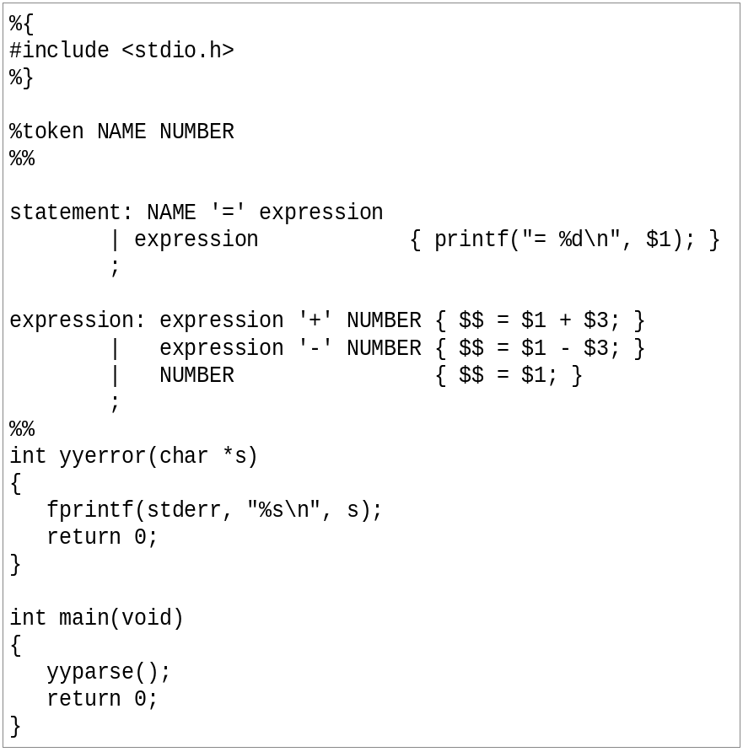
An YACC File Example
CD LAB

Slide 32
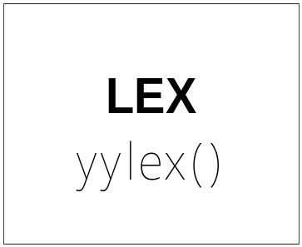
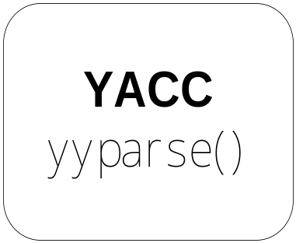
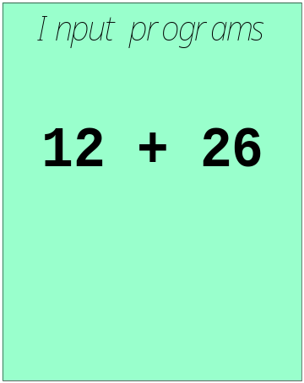

Works with Lex
How to work ?
CD LAB

Slide 33
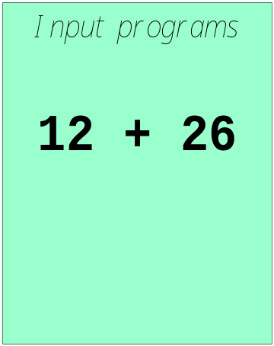
Works with Lex
[0-9]+
call yylex()
next token is NUM
NUM ‘+’ NUM
CD LAB

Slide 34
YACC File Format
%{
  C declarations
  %}
  yacc declarations
  %%
  Grammar rules
  %%
  Additional C code
  Comments enclosed in /* ... */ may appear in any of the sections.
CD LAB

Slide 35
Definitions Section
%{
#include <stdio.h>
#include <stdlib.h>
%}
%token ID NUM
%start expr
It is a terminal
CD LAB

Slide 36
Start Symbol
The first non-terminal specified in the grammar specification section.
To overwrite it with %start declaraction.
%start non-terminal
CD LAB

Slide 37
Rules Section
This section defines grammar
Example
expr : expr '+' term | term;
term : term '*' factor | factor;
factor : '(' expr ')' | ID | NUM;
CD LAB

Slide 38

Rules Section
Normally written like this
Example:
expr : expr '+' term
| term
;
term : term '*' factor
| factor
;
factor : '(' expr ')'
| ID
| NUM
;
CD LAB

Slide 39
The Position of Rules
expr : expr '+' term { $$ = $1 + $3; }
| term { $$ = $1; }
;
term : term '*' factor { $$ = $1 * $3; }
| factor { $$ = $1; }
;
factor : '(' expr ')' { $$ = $2; }
| ID
| NUM
;
CD LAB

Slide 40
The Position of Rules
$1
expr : expr '+' term { $$ = $1 + $3; }
| term { $$ = $1; }
;
term : term '*' factor { $$ = $1 * $3; }
| factor { $$ = $1; }
;
factor : '(' expr ')' { $$ = $2; }
| ID
| NUM
;
CD LAB

Slide 41
The Position of Rules
expr : expr '+' term { $$ = $1 + $3; }
| term { $$ = $1; }
;
term : term '*' factor { $$ = $1 * $3; }
| factor { $$ = $1; }
;
factor : '(' expr ')' { $$ = $2; }
| ID
| NUM
;
$2
CD LAB

Slide 42
The Position of Rules
expr : expr '+' term { $$ = $1 + $3; }
| term { $$ = $1; }
;
term : term '*' factor { $$ = $1 * $3; }
| factor { $$ = $1; }
;
factor : '(' expr ')' { $$ = $2; }
| ID
| NUM
;
$3
Default: $$ = $1;
CD LAB

Slide 43
Communication between LEX and YACC
yacc -d xxx.y
Produced
y.tab.h:
# define CHAR 258
# define FLOAT 259
# define ID 260
# define INT 261
%{
#include <stdio.h>
#include "y.tab.h"
%}
id [_a-zA-Z][_a-zA-Z0-9]*
%%
int { return INT; }
char { return CHAR; }
float { return FLOAT; }
{id} { return ID;}
scanner.l
%{
#include <stdio.h>
#include <stdlib.h>
%}
%token CHAR, FLOAT, ID, INT
%%
parser.y
CD LAB

Slide 44
YACC
Rules may be recursive
Rules may be ambiguous*
Uses bottom up Shift/Reduce parsing
  Get a token
  Push onto stack
  Can it reduced (How do we know?)
    If yes: Reduce using a rule
    If no: Get another token
Yacc cannot look ahead more than one token
Phrase -> cart_animal AND CART
| work_animal AND PLOW
…
CD LAB

Slide 45
Yacc Example
Taken from Lex & Yacc
Simple calculator
  a = 4 + 6
  a
  a=10
  b = 7
  c = a + b
  c
  c = 17
  $
CD LAB

Slide 46
Grammar
expression ::= expression '+' term |
expression '-' term |
term
term ::= term '*' factor |
term '/' factor |
factor
factor ::= '(' expression ')' |
'-' factor |
NUMBER |
NAME
CD LAB

Slide 47
Parser (cont’d)
statement_list: statement '\n'
| statement_list statement '\n'
;
statement: NAME '=' expression { $1->value = $3; }
| expression { printf("= %g\n", $1); }
;
expression: expression '+' term { $$ = $1 + $3; }
| expression '-' term { $$ = $1 - $3; }
| term
;
CD LAB
parser.y

Slide 48
Parser (cont’d)
term: term '*' factor { $$ = $1 * $3; }
| term '/' factor { if ($3 == 0.0)
yyerror("divide by zero");
else
$$ = $1 / $3;
}
| factor
;
factor: '(' expression ')' { $$ = $2; }
| '-' factor { $$ = -$2; }
| NUMBER { $$ = $1; }
| NAME { $$ = $1->value; }
;
%%
CD LAB
parser.y

Slide 49
Scanner
%{
#include "y.tab.h"
#include "parser.h"
#include <math.h>
%}
%%
([0-9]+|([0-9]*\.[0-9]+)([eE][-+]?[0-9]+)?) {
yylval.dval = atof(yytext);
return NUMBER;
}
[ \t] ; /* ignore white space */
CD LAB
scanner.l

Slide 50
Scanner (cont’d)
[A-Za-z][A-Za-z0-9]* { /* return symbol pointer */
yylval.symp = symlook(yytext);
return NAME;
}
"$" { return 0; /* end of input */ }
\n |”=“|”+”|”-”|”*”|”/” return yytext[0];
%%
CD LAB
scanner.l

Slide 51
YACC Command
Yacc (AT&T)
  yacc –d xxx.y
Bison (GNU)
  bison –d –y xxx.y
CD LAB

Slide 52
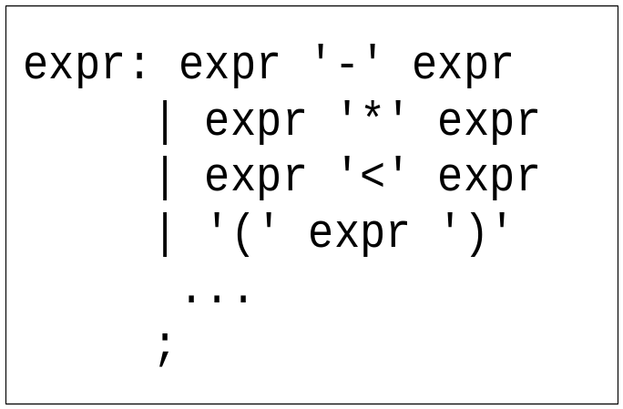
Precedence / Association
(1) 1 – 2 - 3
(2) 1 – 2 * 3
1-2-3 = (1-2)-3? or 1-(2-3)?
Define ‘-’ operator is left-association.
1-2*3 = 1-(2*3)
Define “*” operator is precedent to “-” operator
CD LAB

Slide 53
Precedence / Association
%right ‘=‘
%left '<' '>' NE LE GE
%left '+' '-‘
%left '*' '/'
highest precedence
CD LAB

Slide 54
Precedence / Association
%left '+' '-'
%left '*' '/'
%noassoc UMINUS
expr : expr ‘+’ expr { $$ = $1 + $3; }
| expr ‘-’ expr { $$ = $1 - $3; }
| expr ‘*’ expr { $$ = $1 * $3; }
| expr ‘/’ expr
{
if($3==0)
yyerror(“divide 0”);
else
$$ = $1 / $3;
}
| ‘-’ expr %prec UMINUS {$$ = -$2; }
CD LAB

Slide 55
Shift/Reduce Conflicts
shift/reduce conflict
  occurs when a grammar is written in such a way that a decision between shifting and reducing can not be made.
  ex: IF-ELSE ambigious.
To resolve this conflict, yacc will choose to shift.
CD LAB

Slide 56
YACC Declaration Summary
`%start'
Specify the grammar's start symbol
`%union'
Declare the collection of data types that semantic values may have
`%token'
Declare a terminal symbol (token type name) with no precedence or
associativity specified
`%type'
Declare the type of semantic values for a nonterminal symbol
CD LAB

Slide 57
YACC Declaration Summary
`%right'
Declare a terminal symbol (token type name) that is
right-associative
`%left'
Declare a terminal symbol (token type name) that is left-associative
`%nonassoc'
Declare a terminal symbol (token type name) that is nonassociative
(using it in a way that would be associative is a syntax error,
ex: x op. y op. z is syntax error)
CD LAB

